Slide 1
Microwave Moonbounce Communication. Peter Blair G3LTF

Slide 2
Contents
Early History of Moonbounce
How does Moonbounce Work?
What are the difficulties and how are they overcome?
EME Systems and components
System Measurement and optimisation

Slide 3
Notes:
2.6 deg vertical BW

Slide 4
Notes:
1 deg BW

Slide 5
All the early efforts were on 144MHz with big co-linears, yagi arrays and stacked Rhombics but with limited success

Slide 6
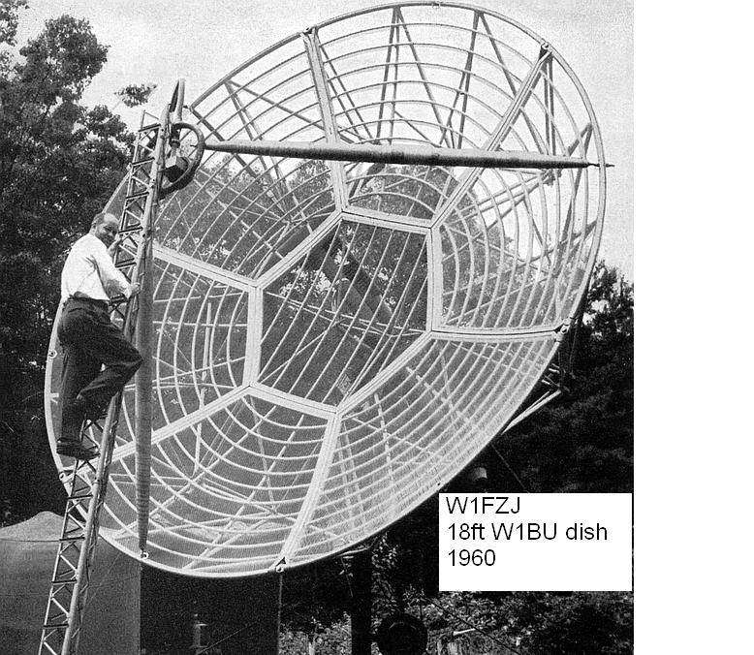
The Father of Microwave EME, Sam Harris W1FZJ
Tremendous progress in 1950s in solid state devices, varactor diodes
Parametric Amplifiers then possible up to several GHz
Microwave Associates had paramps, Eimac had klystrons, find some dishes and its ...Game On!

Slide 7
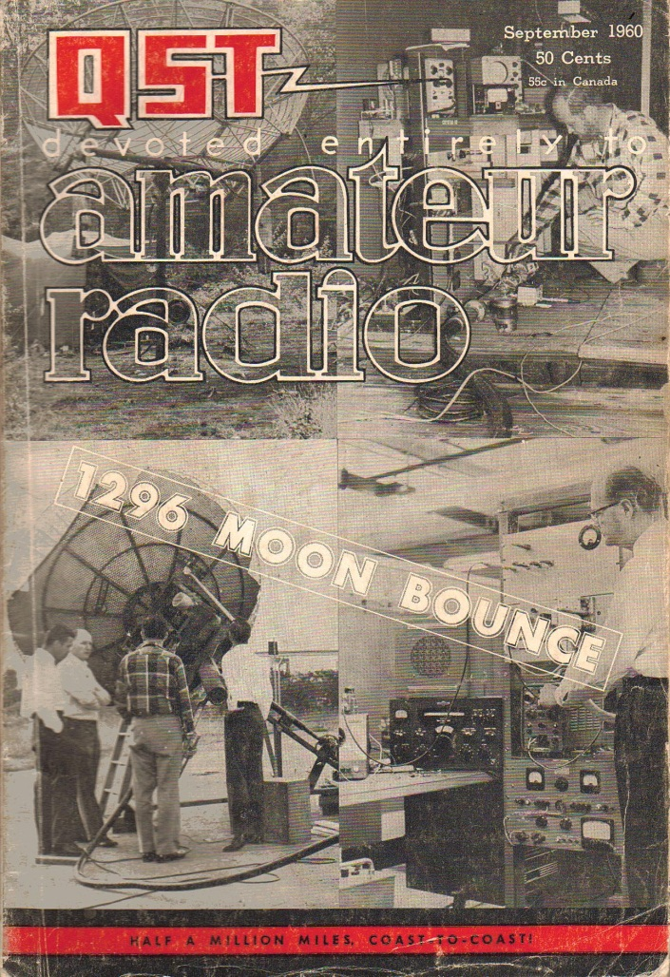
The Big Bang! QST September '60
W1BU works W6HB on 1296MHz via the moon!
Serious VHF/UHF operators everywhere think.....
“How can I copy that?
What do I need?
How do I build a big enough antenna and how do I point it?
How do I generate the power?”
Etc...etc

Slide 8
What happened next?
Lots of dishes built and signals copied from W1BU in USA and Europe, but the next full 1296MHz contacts were in 1962 when W1BU worked W2CXY and KH6UK.
First 144MHz QSO April 1964 W6DNG and OH1NL
First 432MHz QSO May 1964 W1BU and KH6UK
June 1964. KP4BPZ using the Arecibo 1000ft dish works 6 stations on 432 MHz including HB9RG and G3LTF.
September 1964. HB9RG works W1BU on 1296MHz
July 1965. KP4BPZ returns on 432MHz, 28 QSOs and ssb

Slide 9
The 1000ft Spherical reflector at Arecibo used at 432 and 144MHz, KP4BPZ
Notes:
58dBi gain

Slide 10
15ft dish at Galleywood Essex, 1963. ( note co-linear stack antennas for 70 & 23cm tropo)

Slide 11
Now working on 1296MHz, 1968
Notes:
4.8m dish 1968 with circular waveguide feed 19mm mesh Simple wooden hub and arms

Slide 12
Dish # 2, 1970-1993 0.5 – 0.37 f/D 4.8m>6.5m moved location 3 times
Notes:
The arms on this dish, cut from plywood lasted 23 years… next slide

Slide 13
Today, NW Hampshire, 6m Dish #8, all aluminium, 0.375 f/D 6mm mesh, works at 5760MHz
Notes:
6mm mesh and improved profile in the outer sections meant it worked reasonably well up to 6cm.

Slide 14
There are only two equations that you need for sucessful EME……
(1) The “radar” equation
S/N = [K*Gr*Gt* Pt] / [R^4* Tsys* Br]
Gr, Gt are the Antenna gains
Pt Transmitter power at the antenna
Tsys System Temperature
Maximising G/T is the key to performance
R moon distance
Br Receiver detection bandwidth
K contains all the boring constants. Equation (2) comes later

Slide 15
On the path from transmitter to the receiver detector the signal is affected by a number of obstacles
Path Loss
Polarisation change
Geometrical and Faraday Rotation
Ionospheric losses (only at lower frequencies)
Time Delay …… average value 2.5 seconds
Doppler Shift
Signal spreading at microwave frequencies
Noise
Notes:
Iono loss at 144 in daylight typically 0.5dB More in disturbed inonosphere or though Auroral zones.

Slide 16
Path Loss is high but with the same size dish at each end and same power and receive system noise figure….. Higher frequencies give much better signals

Slide 17
On the path from transmitter to the receiver detector the signal is affected by a number of obstacles
Path Loss
Polarisation change
Geometrical and Faraday Rotation
Ionospheric losses (only at lower frequencies)
Time Delay …… average value 2.5 seconds
Doppler Shift
Signal spreading at microwave frequencies
Noise
Notes:
Iono loss at 144 in daylight typically 0.5dB More in disturbed inonosphere or though Auroral zones.

Slide 18
Geometric Polarisation Rotation

Slide 19
Faraday Rotation. As a wave travels through the ionosphere its polarisation rotates depending on the total electron density and the magnetic field along its path. The effect varies as wavelength squared. It is negligible above 23cm. Using Circular Polarisation overcomes ALL polarisation problems. CP is used almost exclusively on microwave EME.

Slide 20
On the path from transmitter to the receiver detector the signal is affected by a number of obstacles
Path Loss
Polarisation change
Geometrical and Faraday Rotation
Ionospheric losses (only at lower frequencies)
Time Delay …… average value 2.5 seconds
Doppler Shift
Signal spreading at microwave frequencies
Noise
Notes:
Iono loss at 144 in daylight typically 0.5dB More in disturbed inonosphere or though Auroral zones.

Slide 21
On the path from transmitter to the receiver detector the signal is affected by a number of obstacles
Path Loss
Polarisation change
Geometrical and Faraday Rotation
Ionospheric losses (only at lower frequencies)
Time Delay …… average value 2.5 seconds
Doppler Shift
Signal spreading at microwave frequencies
Noise
Notes:
Iono loss at 144 in daylight typically 0.5dB More in disturbed inonosphere or though Auroral zones. Scales as 1/F^2

Slide 22
Doppler Shift and Signal Spreading
Doppler shift comes from the relative motion of Earth and Moon, mainly from Earth’s rotation. (Think of the train whistle effect)
Total Doppler shift is the sum of each stations individual Doppler shift
Due to Moon’s slightly eccentric orbit the relative velocity varies at about 0.2m/S. This is called Libration
At microwave frequencies this causes spreading of the signal

Slide 23
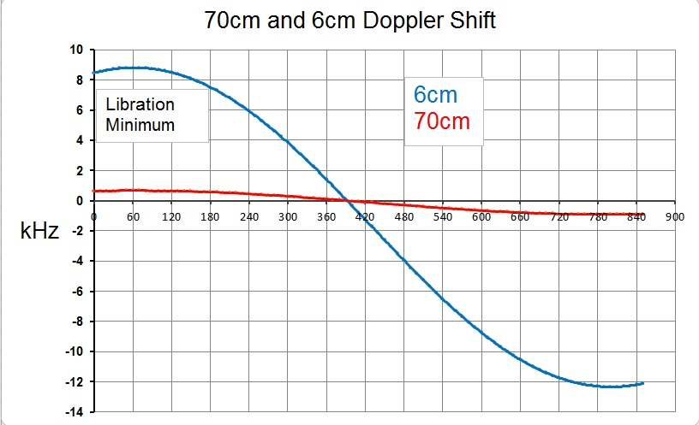
Time, min from Moon rise

Slide 24
Libration Spreading OK1KIR 6cm
Calculated Libration (by G3WDG) 78Hz

Slide 25
On the path from transmitter to the receiver detector the signal is affected by a number of obstacles
Path Loss
Polarisation change
Geometrical and Faraday Rotation
Ionospheric losses (only at lower frequencies)
Time Delay …… average value 2.5 seconds
Doppler Shift
Signal spreading at microwave frequencies
Noise
Notes:
Iono loss at 144 in daylight typically 0.5dB More in disturbed inonosphere or though Auroral zones.

Slide 26
Noise
Noise is caused by the random movement of electrons colliding with ions in a conductor
At absolute zero, 0 degrees Kelvin, or minus 273C, no noise is generated.
Noise power ~ kTB k is constant and B is fixed so noise power can be represented by T called the Noise Temperature.
Deepest outer space is close to 0K, actually it’s 3.4K, the remnant of the Big Bang.

Slide 27
The discovery of the cosmic microwave background in 1964 at Holmdel NJ
“I still can’t account for that last 3.4K”
By NASA - Great Images in NASA Description, Public Domain
Notes:
Penzias and Wilson

Slide 28
Our signal returning from the moon has to battle against NOISE from several sources.
Noise picked up by the antenna together with the signal
Noise generated in any lossy components in the signal path
Noise generated by the amplifier in the receiver system
Other users of the microwave bands, mobile radio / TV and Wi-Fi

Slide 29
Noise comes into the antenna from the sky via the main beam and from the ground via far-out sidelobes, also called spill-over. A long way down.… but the ground is hot.
Sky background 4-100K depending on frequency and elevation
Good feed system design minimises this
Ground 300K

Slide 30
The sky temperature,Tsky, is frequency and elevation dependent

Slide 31
A map at 408MHz of the sky temperature. Today the moon is in a very quiet part of the sky.

Slide 32
Our signal returning from the moon has to battle against NOISE from several sources.
Noise picked up by the antenna together with the signal
Noise generated in any lossy components in the signal path
Noise generated by the amplifier in the receiver system
Other users of the microwave bands, mobile radio / TV and Wi-Fi

Slide 33
OZ1LPR 6cm system. Minimal loss from horn to LNA
Feed
Driver
Relay
100W PA
LNA
Transverter

Slide 34
We must minimise the noise added by the receiver front end. This means a low noise temperature, Trx ( low NF)
G4DDK 23cm VLNA Trx 17K
(0. 24dB)
The clever bit in detail, 13cm.

Slide 35
G3LTF built 6cm LNA 0.65dB NF (W5LUA design with ATF36077)

Slide 36
3cm LNAs
Modified LNB 1dB NF
DB6NT LNA 0.7dB NF

Slide 37
The big change in 50 years is in the receiver system technology.
My 23cm Parametric Amplifier
7 interacting adjustments!
NF 1-2dB with 20dB gain
Pressurised air-spaced cable, but still about 1dB loss

Slide 38
Our signal returning from the moon has to battle against NOISE from several sources.
Noise generated in any lossy components in the signal path
Noise generated by the amplifier in the Noise picked up by the antenna together with the signal
receiver system
Other users of the microwave bands, mobile radio / TV and Wi-Fi
Low side-lobes, good RF filtering after the LNA, is about all we can do to combat these sources

Slide 39
All of the noise contributions add up.
If we think about, and measure, everything in terms of its Noise Temperature then its very easy to work out how good our system is and what is important.
We just add all the temperature contributions, so…..
T system = T sky + T spillover +T loss + T rx
A good system would be about 48K at 23cm and 90K at 3cm.
At 23cm and above T spillover and Trx dominate.
The moon’s thermal noise will contribute as the antenna beamwidth approaches 0.5 degree.

Slide 40
The second important equation for successful EME…..
10 x 0.1 dB = 1dB
or even more…

Slide 41
We have some software that does all the calculations of system performance
EMECalc written by the late VK3UM
http://www.vk3um.com/eme%20calculator.html

Slide 42
EMECalc software estimates EME system performance. VK3UM Software

Slide 43
EME systems and Components
Antennas and Transmitters
(we covered preamps earlier)

Slide 44
Antennas for Microwave EME
At 23cm and up reflectors are easily the best
Single feed point allows low losses
Pattern and polarisation can be well controlled
Multiband operation from one antenna
Prime focus, Off-set, Cassegrain
Surface can be solid or mesh
Build-your-own very feasible up to 15m diameter

Slide 45
Next….Some dishes Large and Small
In the mid 1950s I recall putting some shillings into a tin at the RSGB London VHF club meeting to help pay for this wonderful antenna!

Slide 46
PA3FXB 3m dish for 23cm
The Dutch are very good at fitting 2.4 -3.5m dishes into their small gardens. Jan also used this for an ISS bounce contact

Slide 47
The 25m Dish at Dwingelo, Holland restored by the “CAMRAS” team. Used on 70cm to 6cm
Multiband feed system
PI9CAM… CW, SSTV, JTxx , SSB

Slide 48
Standardised plugs and wing nuts makes feed changing easy for multiband contests. BUT…. a safe access platform is essential
13cm feed, PA below the dish, transverter in the shack
9cm feed, transverter and PA at the feedpoint

Slide 49
G4CCH 5.4m dish 0.5f/D Operates 70cm to 6cm

Slide 50
Two compact EME systems, working on 23cm to 3cm and 13cm
G4BAO 1.9m dish
K1DS “Driveway” 3m dish system
G4BAO
23cm 200W
112 initials
34 CW, 2ssb
13cm 210W
49 initials
27CW, 4ssb
9cm 60W
8 initials
2CW
6cm 30W
13 initials
2CW
3cm 12W
3 initials

Slide 51
Other types of microwave dishes, PA7JB’s offset fed dish and G4NNS’s cassegrain

Slide 52
23cm - SSPAs replacing tubes 6x 3CX100A5 800W G4CCH 4x 250W SSPA

Slide 53
JA4BLC 100W PA for 6cm SM6PGP design

Slide 54
DL7YC 24GHz system, 2.4m dish
Fully integrated focus box
TWA modified to 24GHz to give 30-50W

Slide 55
The ultimate in microwave EME 76GHz, Echoes received. See www.microwavers.org RW3BP

Slide 56
What does a system block diagram look like?

Slide 57
G3LTF 23cm System
PSUs
3dB loss
96MHz
6x
3CX100A5
PA
Driver
400W
OCXO
Transverter
CP
Feed
40dB Gain
Relay
LNA
144-14MHz
SDR
50R Load
TS850S
Spectran
Dish Feed-point
Shack
Tuneable
Audio
Filter

Slide 58
G3LTF 6cm System
PSUs
Control
87.75MHz
40W
OCXO
SSPA
Driver
4W
CP
Feed
Transverter
Relay
LNA
144-14MHz
SDR
50R Load
TS850S
Spectran
Dish feed-point
Shack
Tuneable
Audio
Filter

Slide 59
Operating Modes CW SSB Digital, JTxx

Slide 60
My preference is CW…. 25kHz of 23cm CW in the ARRL contest

Slide 61
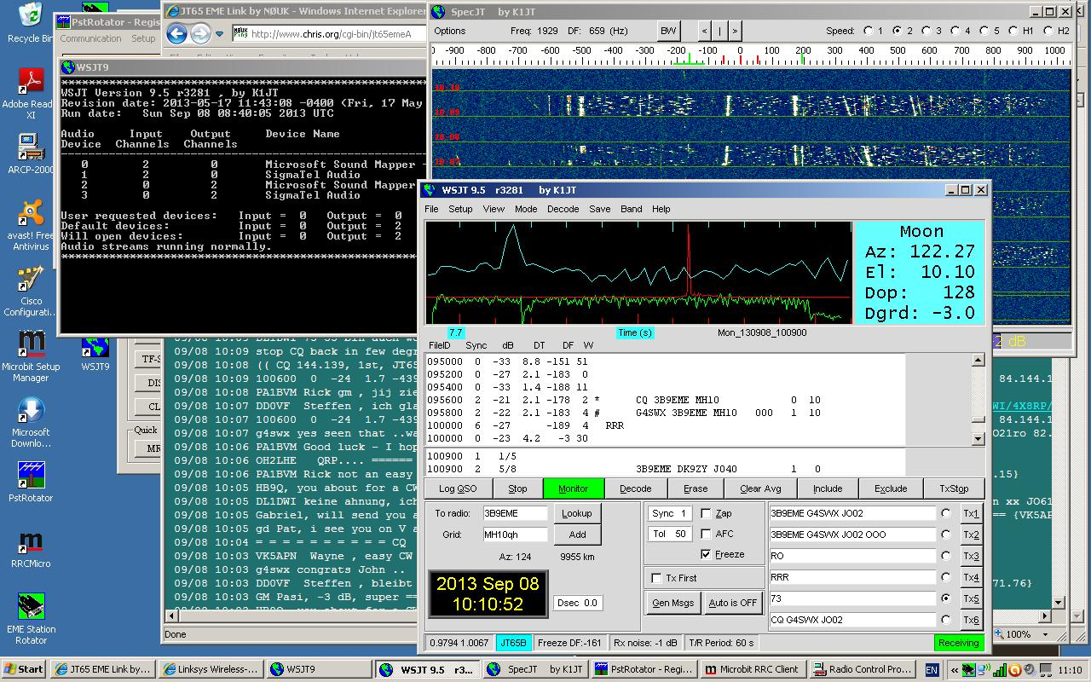
Many prefer JT65 with a 10-12dB advantage over CW

Slide 62
System measurement and optimisation
Sun noise measurement gives G/T estimate
Moon noise can give more accuracy
Sun drift through can give beamwidth
Ground to Cold Sky measurement useful but more complex than it first appears
VK3UM’s EMECalc programme can help analyse the results

Slide 63
NF estimation using cold sky to ground

Slide 64
Y= [Tsys +Thot] / [Tsys +Tcold] Gives result Tsys = 105-120K Same method used for the antenna but with correction for source (sun / moon) not filling the beam.
“Hot” absorber, 290K
Cold Sky Level ~8K

Slide 65
Moon noise measurement at 6cm using 6m dish, 1.2-1.3dB

Slide 66
Thankyou for Listening
Acknowlegements
I am very grateful to Matej, OK1TEH for the use of some of his slides and to many others who have provided pictures and data.

Slide 67
Some useful EME sites
http://www.df2zc.de/newsletter/ 2m NL
http://www.nitehawk.com/rasmit/em70cm.htm 70cm^NL
http://www.nlsa.com/nets/moon-net-help.html Refl’tor
mailto:moon@moonbounce.info Reflector
http://www.physics.princeton.edu/pulsar/K1JT/ WSST
http://physics.princeton.edu/pulsar/K1JT/Hbk_2010_Ch30_EME.pdf ARRL Handbook EME Section
http://www.moonbouncers.org/ Good tech info
http://www.qsl.net/dk7zb/ Great HB Yagis that work
http://www.hb9q.ch/hb9q/ HB9Q logger
http://www.chris.org/cgi-bin/jt65emeB N0UK logger
http://www.w1ghz.org/antbook/contents.htm Dishes
http://www.vk3um.com/software.html Planner, Analysis++

